Slide 1

DATA SCIENCE PROJECT
FINDINGS
Aug 9 2023
Big Mountain Resort

Slide 2

Unveiling Big Mountain Resort
Context
Problem Identification
Key Data Sources Utilised
Big Mountain Resort, located in the state of Montana, has access to 105 trails, attracting about 350,000 visitors annually.
The resort boasts 11 lifts, including a recent chairlift addition that has increased operational costs to $1,540,000 this season.
The resort's current pricing strategy that is based on market averages are limiting it’s ability to fully capitalize on their facilities and potential for revenue optimization.
The resort is seeking data-driven insights and recommendations to address this issue and make more informed decisions regarding ticket pricing and facility utilization.
Therefore, the main goal of this analysis is to identify the right price to increase revenue and optimise the use of Big Mountain Resort’s facilities
Ski data
State summary(Source: Wikipedia)

Slide 3

Recommendations
01
TICKET PRICE INCREASE
02
Option 1: ENHANCE VERTICAL DROP
Big Mountain Resort’s current weekend ticket price is $81.00
Model predicted ticket price is $97.96, with an expected mean absolute error of $10.36.
This indicates a potential price increase is possible.
The model suggests that, adding a run, increasing the vertical drop by 150 feet, and installing an additional chair lift, increases support for ticket price by $2.22. Over the season, this could be expected to amount to $3,888,889
03
Option 2: CONSIDER CLOSING RUNS
04
ADDITIONAL DATA
The analysis indicates that:
Closing 1 or 2 runs has minimal impact, closing 3 runs reduces support for ticket price and revenue.
Closing 4 or 5 runs does not result in further loss in ticket price. Beyond that, a significant drop in ticket price occurs.
Therefore, closing up to 5 of the least used runs could lead to cost savings without significant revenue loss.
Performing further analysis with data on the following areas would enhance the model's predictive accuracy :
Comprehensive cost data
External factors such as local economic conditions and demand
Visitor demographics and preferences

Slide 4
Results and Analysis
Initial Findings
Key features identified
The following conclusions were made from the initial Exploratory Data Analysis:
The following features were identified as being the most important in influencing a change in ticket price:
Vertical drop
Snow Making
Number of total chairs
Fast quads
Runs
Length of the longest Run
Trams
Size of skiable terrain
Offering more night skiing capacity might enable resorts to charge higher prices
Having more runs and adequate chairlifts may also positively influence pricing.
Guaranteed snow cover is more important for customers compared to larger size of terrain area.
The state a resort is located in, doesn’t seem to have a noticeable impact on it’s ticket price

Slide 5
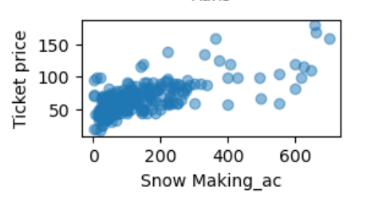
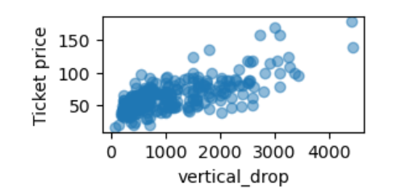
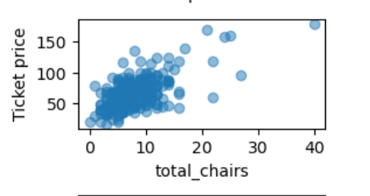
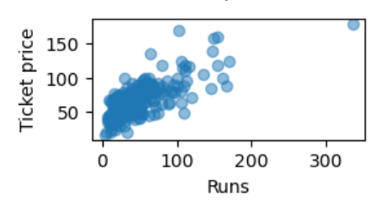
Feature Correlations & Positioning Insights
Vertical drop
Snow making area
Our initial analysis shows that ticket price has a strong positive correlation with vertical_drop.
Compared to other resorts in the market, Big Mountain Resort performs well in vertical drop, although some resorts exceed its drop.
Snow making area also has a correlation with ticket price, in fact the analysis reveals that, guaranteed snow cover is more important for customers compared to larger size of terrain area Big Mountain Resort ranks very high in snow making area.
Runs
Number of chairs
Runs and total_chairs also show higher correlations with ticket prices, which could mean that having more runs and adequate chairlift.
Big Mountain Resort compares well in the number of runs, with a few resorts having more.s may also positively influence pricing.
Having a higher number of chairs shows a higher correlation with ticket price. Findings also suggest that resorts with a higher ratio of total_chairs to Runs tends to have lower ticket prices.
Big Mountain Resort has a substantial number of total chairs, compared to others in the market, with a few resorts having more, which are considered outliers.

Slide 6
Using a linear regression model, on average, the model could estimate a ticket price within approximately 9 dollars of the actual price, which was much better than a simple guess based on the average value (with a variance of 19 dollars).
The random forest model has a lower cross-validation mean absolute error by almost $1. It also exhibits less variability. Verifying performance on the test set produces performance consistent with the cross-validation results.
Although the linear regression model was proven to be better than using the average(mean), comparing and validating the performance of the random forest model on the test set yielded a more consistent results, affirming the reliability and effectiveness of this model for predicting ticket prices.
The Model
A Random Forest Model was selected

Slide 7
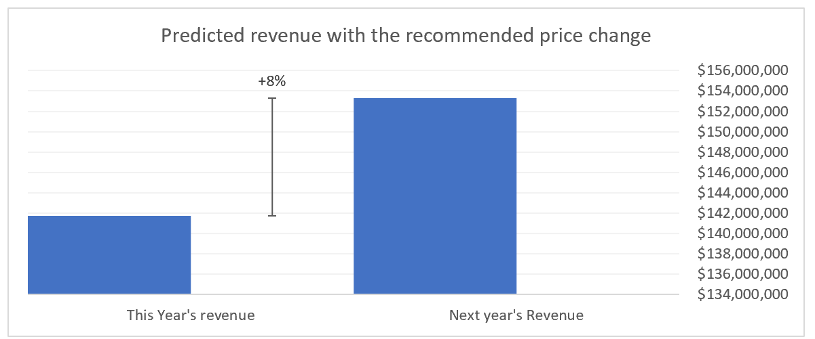
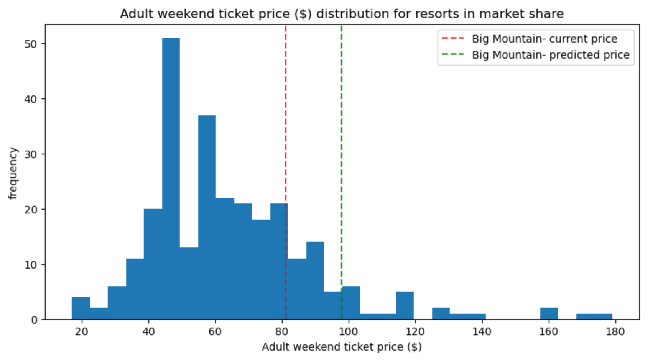
Elevating Returns: Impact of a Price Adjustment on Big Mountain Ski Resort
Big Mountain’s position
Elaborate on what you want to discuss.
The following figure shows a comparison of Big Mountain Resort’s current price and the model predicted price with prices of other resorts in the market
NB: Using this model, to predict potential revenue for Big Mountain Resort with a predicted price of 97.96 and considering the marginal average error of $10.36, the resort can safely make a price increase upto $86.3.
The expected number of visitors over the season is 350,000 and, on average, visitors ski for five days.
With this assumption, Big Mountain Resort can achieve a revenue increase of up to 8% over the season.

Slide 8
Scenario Assessment
Results of various scenarios tested by the model:
SCENARIO 1:
SCENARIO 2:
SCENARIO 3:
SCENARIO 4:
Permanently Closing Least Used Runs
Increase Vertical Drop with Additional Chair Lift
Increase Vertical Drop with Chair Lift and Snow Making
Increase Longest Run with Additional Snow Making Coverage
The analysis indicates that closing up to 5 of the least used runs could lead to cost savings without significant revenue loss.
This increases support for ticket price by 2.22 dollars, which over the season could amount to a revenue increase of $3,888,889.
The addition of snow making coverage in this scenario does not yield any additional benefits in terms of ticket price or revenue compared to Scenario 2.
Despite increasing the longest run and adding snow making coverage, this scenario does not result in a change in ticket price or revenue

Slide 9
Summary and conclusion
This model predicts a ticket price of $97.96 for Big Mountain Resort, accompanied by an expected mean absolute error of $10.36. A comparison with the current ticket price of $81.00 suggests room for a potential increase. With a strategic price increase, Big Mountain Resort can achieve a revenue increase of up to 8% over the season.
Scenario modeling emphasizes the potential benefits of enhancing the vertical drop and potentially undertaking a strategic closing of underutilized runs.
To ensure seamless utilization of this model, we propose the development of an interactive dashboard that allows real-time scenario testing.
While our analysis lays a robust foundation, we recognize the potential for further refinement. Incorporating visitor demographics, external influences, and comprehensive cost data would enhance the model's predictive accuracy.

Slide 10
THANK YOU

